Slide 1

CRIME DATA ANALYSIS - 2022
BY MALLESH H

Slide 2
CRIME DATA ANALYSIS
Cases in each type crime
District wise crime distribution
Cases registered in each month of 2022
Cases registered in each police control area (BEAT)
Ward wise crime distribution
Arrest rate evaluation
Most frequent crime descriptions
Domestic crime proportion analysis
Location description wise crime analysis
Ward needs to be increase security to reduce crime
Main tab
Locality tab
Exploration tab

Slide 3
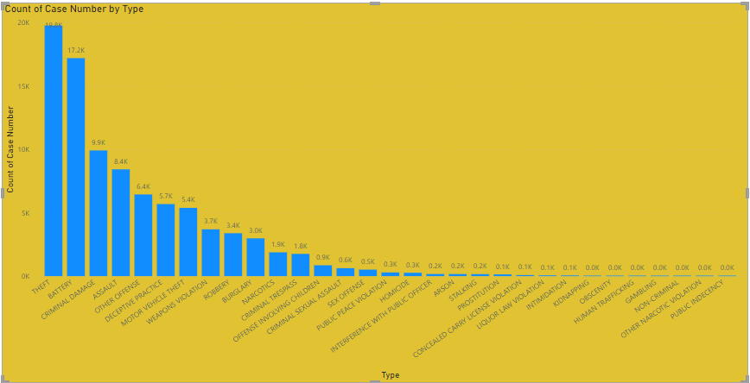
Cases in each type crime
Theft is a most common type of crime

Slide 4
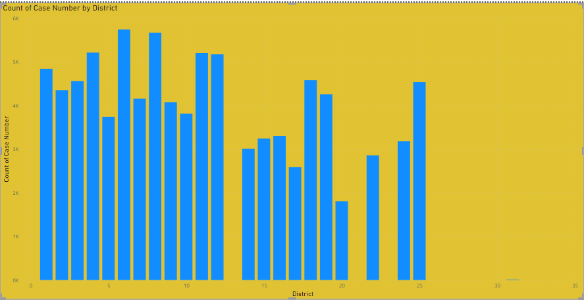
District wise crime distribution
District 6 has most crimes compare to other districts

Slide 5
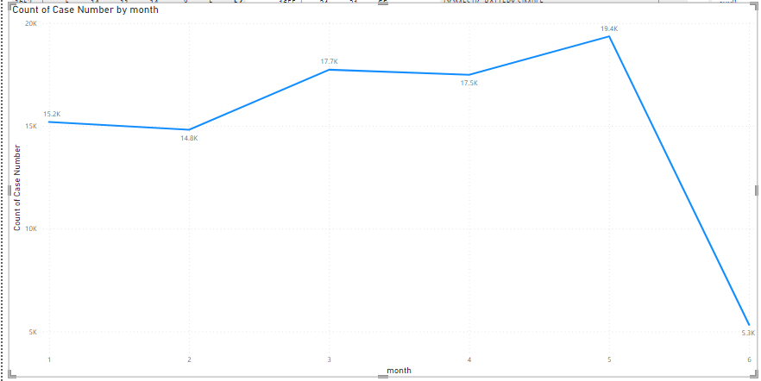
Cases registered in each month of 2022
As per data there is no reduce in monthly crimes

Slide 6
Steps needs to reduce crimes
Community Engagement and Policing: Encourage community involvement in crime prevention efforts through neighborhood watch programs, community policing initiatives, and collaboration with law enforcement agencies. Building trust between law enforcement and the community can lead to better crime reporting and cooperation in crime prevention efforts.
Targeted Enforcement: Prioritize enforcement efforts in high-crime areas and focus on addressing specific types of crimes that have a significant impact on public safety. Deploy resources strategically to target known crime hotspots and repeat offenders.
Crime Prevention Through Environmental Design (CPTED): Implement urban planning and design principles that discourage criminal behavior and promote safety in public spaces. This includes improving lighting, enhancing natural surveillance, and reducing opportunities for crime through environmental modifications.
Addressing Root Causes: Identify and address underlying social, economic, and environmental factors that contribute to crime, such as poverty, unemployment, substance abuse, and lack of access to education and social services. Investing in programs that address these root causes can help prevent crime in the long term.

Slide 7
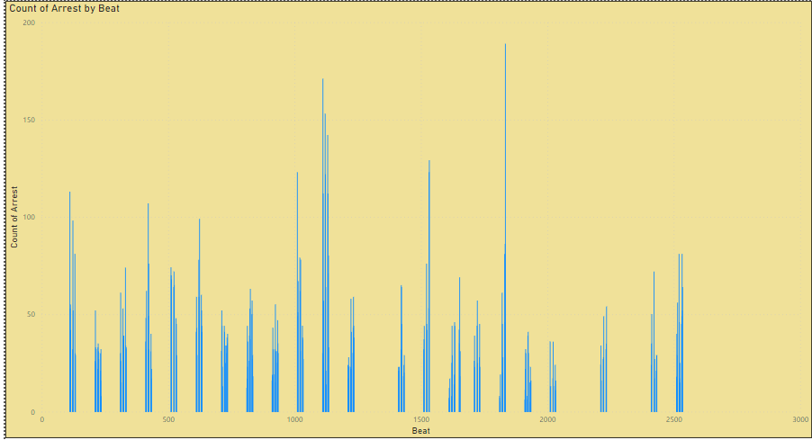
Cases registered in each police control area (BEAT)
Beat no 1655,1652,1653,1654 are the under control

Slide 8
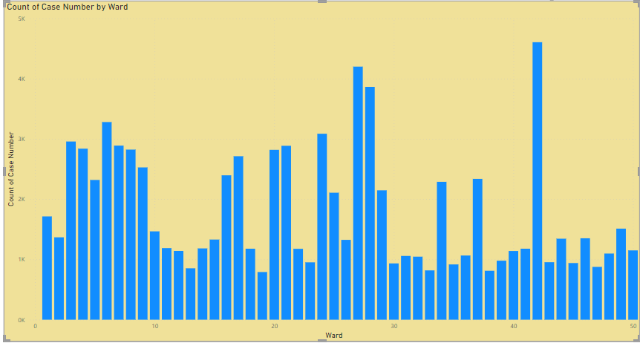
Ward wise crime distribution
Ward 42 has highest crimes

Slide 9
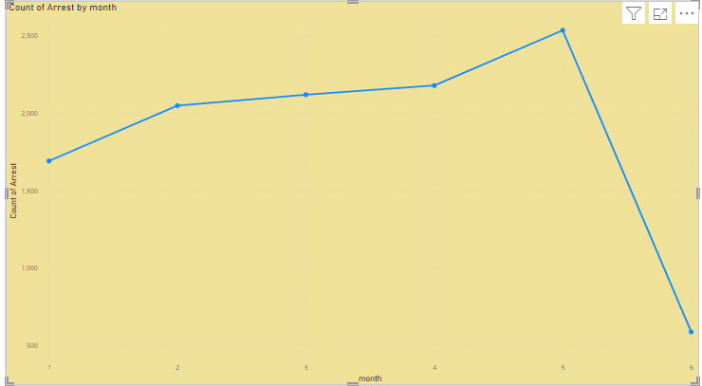
Arrest rate evaluation
Arrest rate is increasing

Slide 10
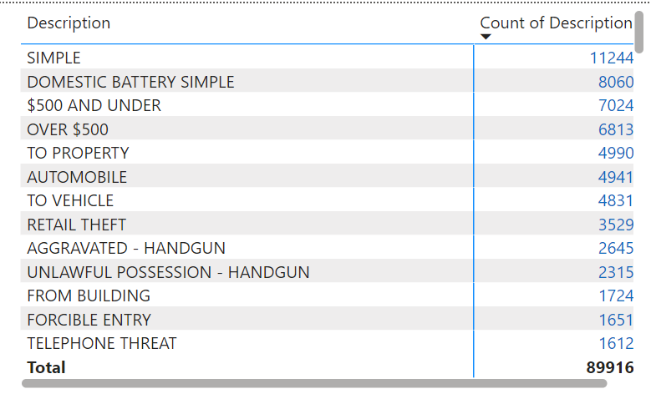
Most frequent crime descriptions

Slide 11
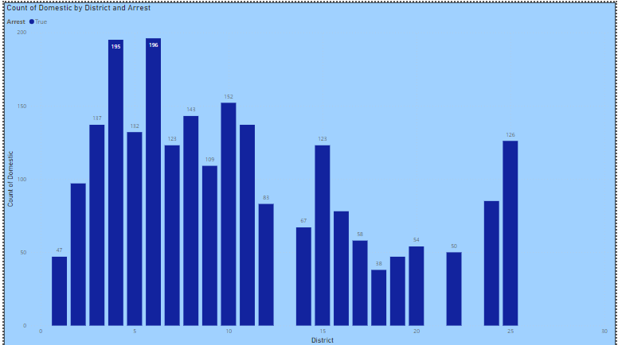
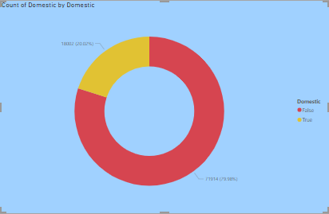
Domestic crime proportion analysis

Slide 12
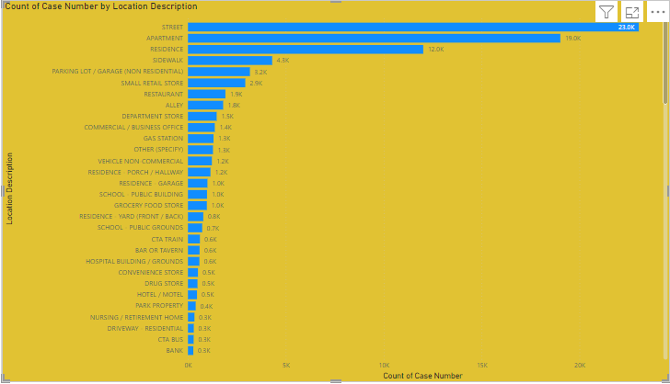
Location description wise crime analysis
Most of crimes occurred in Streets

Slide 13
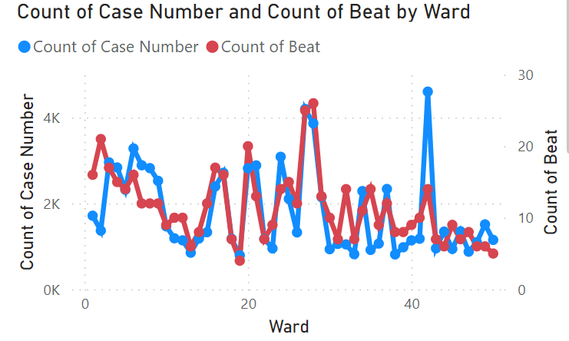
Ward needs to be increase security to reduce crime
wards with numbers 6, 7, 8, 42, 48, and 50 require additional security measures.

Slide 14
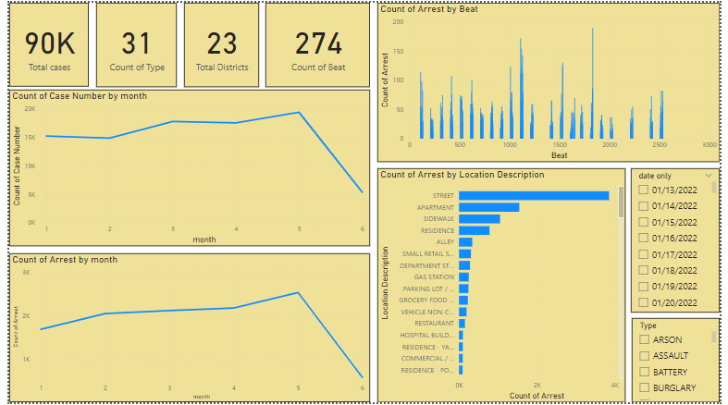
Main tab

Slide 15
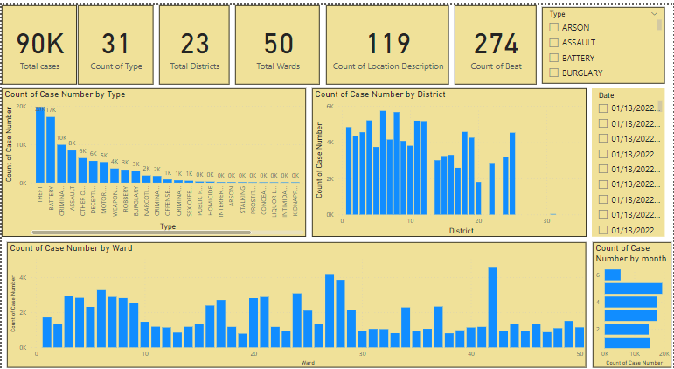
Locality tab

Slide 16
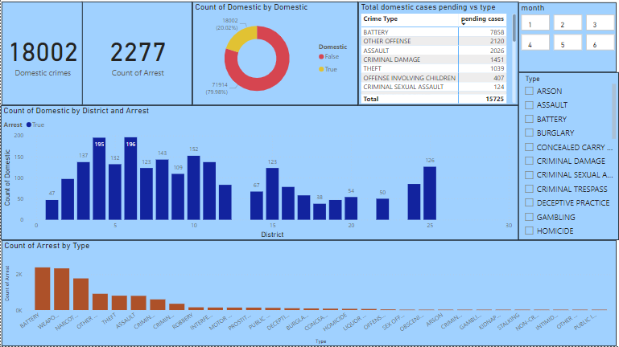
Exploration tab

Slide 17
Conclusion
Average time for case solving is decreased monthly, average case solving time is 10.72 in jan-2023 and 7.08 in june-2023.
Street,Apartment,Resident and Side walk are the localities contains higher crime rates.
measures to controll crime rates
Community Engagement and Policing: Encourage community involvement in crime prevention efforts through neighborhood watch programs, community policing initiatives, and collaboration with law enforcement agencies. Building trust between law enforcement and the community can lead to better crime reporting and cooperation in crime prevention efforts.
Targeted Enforcement: Prioritize enforcement efforts in high-crime areas and focus on addressing specific types of crimes that have a significant impact on public safety. Deploy resources strategically to target known crime hotspots and repeat offenders.
Crime Prevention Through Environmental Design (CPTED): Implement urban planning and design principles that discourage criminal behavior and promote safety in public spaces. This includes improving lighting, enhancing natural surveillance, and reducing opportunities for crime through environmental modifications.
.

Slide 18
THANK YOU

